Slide 1
Notes:
Poll Title: Do not modify the notes in this section to avoid tampering with the Poll Everywhere activity. More info at polleverywhere.com/support Test Question: Who the lady lying under lieutenant Frank Drebin? https://www.polleverywhere.com/multiple_choice_polls/qa8mVmPWXjkFBF0VdOEeX?display_state=chart&activity_state=opened&state=opened&flow=Default&onscreen=persist

Slide 2
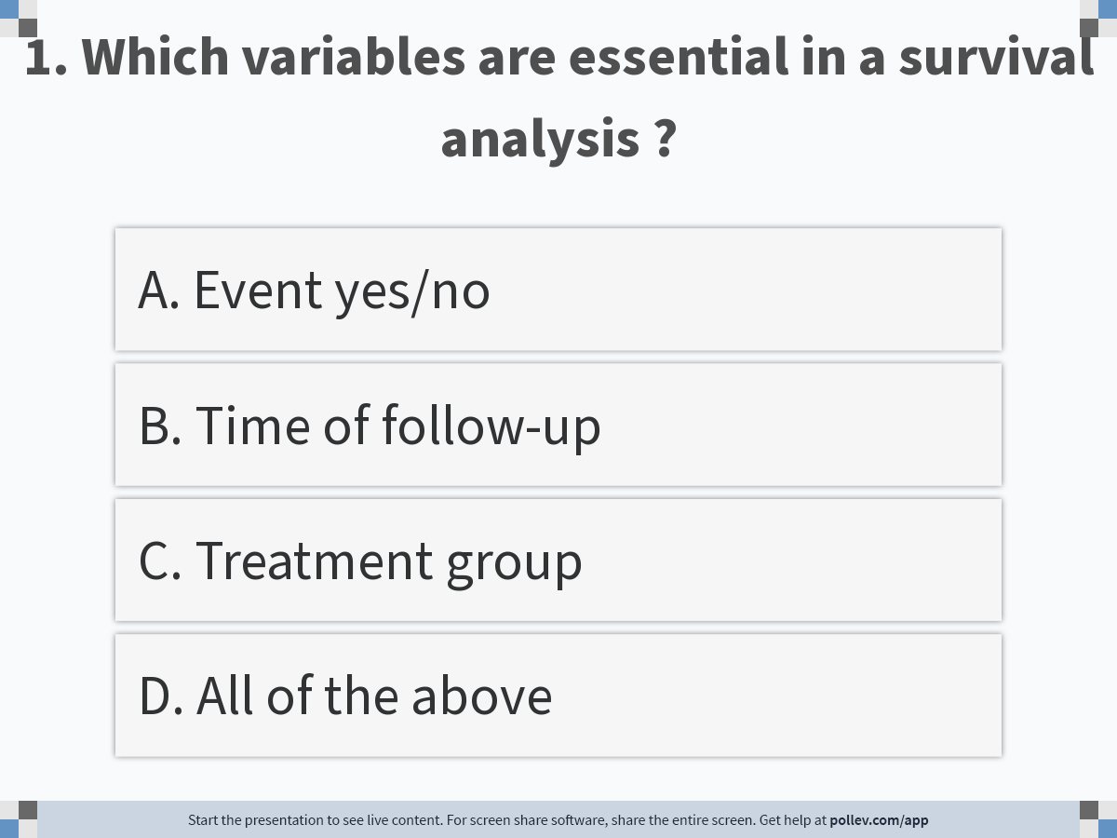
Notes:
Poll Title: Do not modify the notes in this section to avoid tampering with the Poll Everywhere activity. More info at polleverywhere.com/support 1. Which variables are essential in a survival analysis ? https://www.polleverywhere.com/multiple_choice_polls/hgMGalwuLXwXdLi9ACB3z?display_state=instructions&activity_state=opened&state=opened&flow=Engagement&onscreen=persist

Slide 3
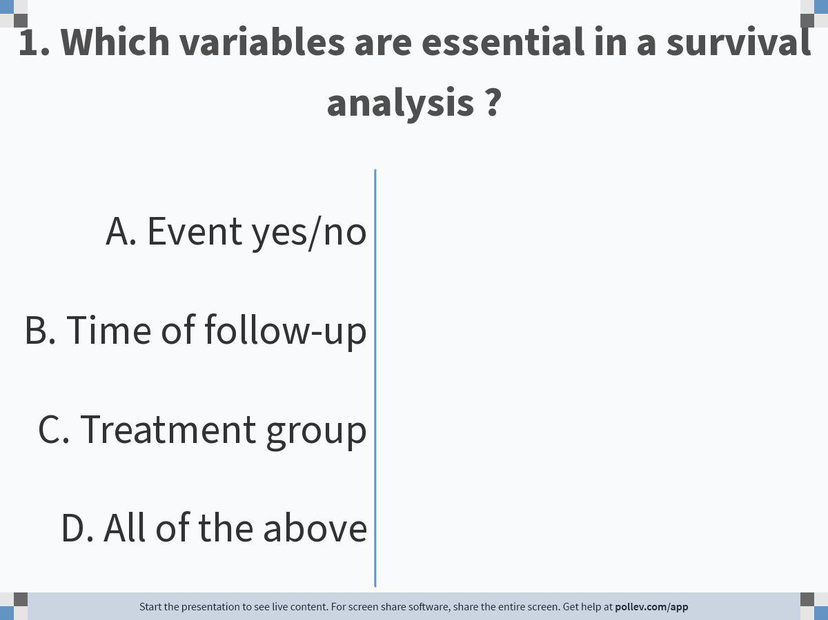
Notes:
Poll Title: Do not modify the notes in this section to avoid tampering with the Poll Everywhere activity. More info at polleverywhere.com/support 1. Which variables are essential in a survival analysis ? https://www.polleverywhere.com/multiple_choice_polls/hgMGalwuLXwXdLi9ACB3z?display_state=chart&activity_state=opened&state=opened&flow=Engagement&onscreen=persist

Slide 4
Notes:
Poll Title: Do not modify the notes in this section to avoid tampering with the Poll Everywhere activity. More info at polleverywhere.com/support 1. Which variables are essential in a survival analysis ? https://www.polleverywhere.com/multiple_choice_polls/hgMGalwuLXwXdLi9ACB3z?display_state=chart&activity_state=closed&state=closed&flow=Engagement&onscreen=persist

Slide 5
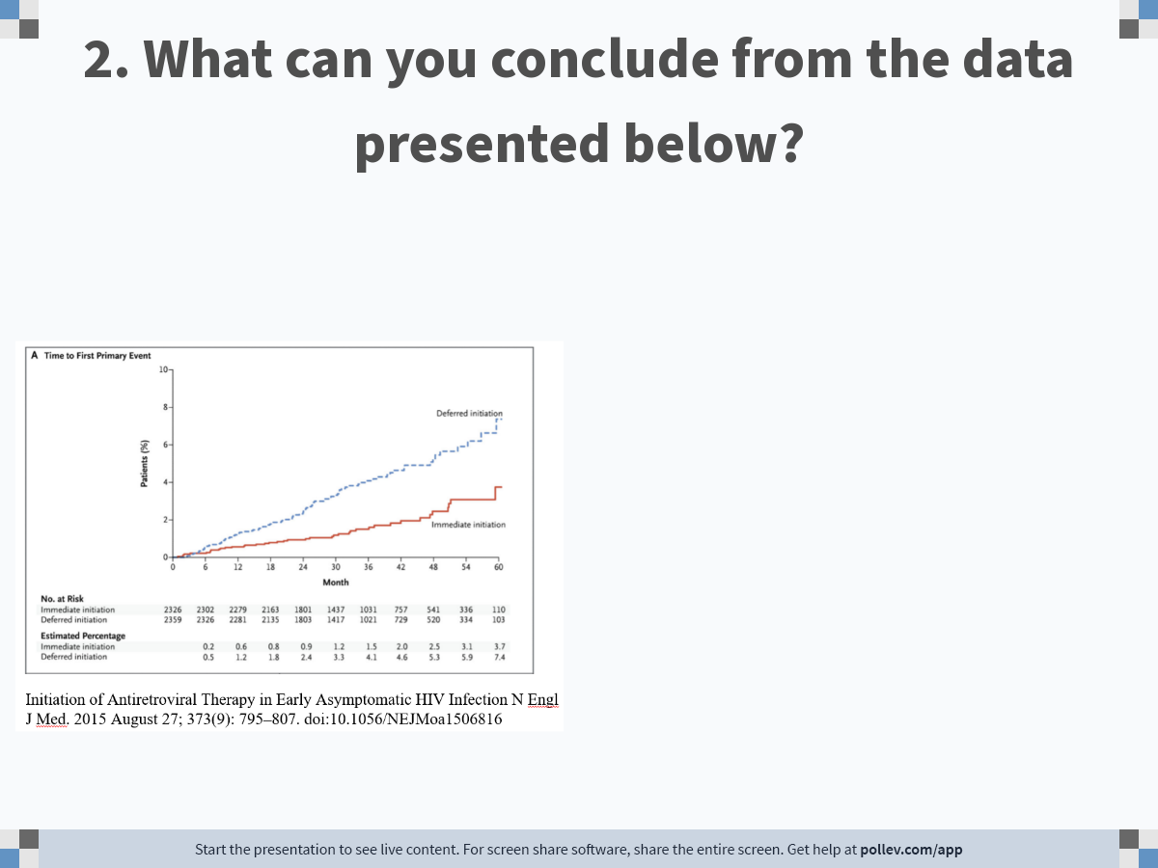
Notes:
Poll Title: Do not modify the notes in this section to avoid tampering with the Poll Everywhere activity. More info at polleverywhere.com/support 2. What can you conclude from the data presented below? https://www.polleverywhere.com/free_text_polls/wyMqlPHK3vwmuHXp8cYyC

Slide 6
Question 2. The graph shows the hazard of experiencing any serious AIDS-related event, serious non–AIDS-related event, or death from any cause, among asymptomatic HIV positives started on ART with a CD4+ count of more (red) than 500 cells per mm³ or after the CD4+ count decreased to 350 cells per mm³ (blue).
Deferred initiation of ART increases time till first event
Deferred initiation of ART decreases time till first event
Deferred initiation of ART is unrelated to time till first event
The difference in time to first event between the two groups is non-significant

Slide 7
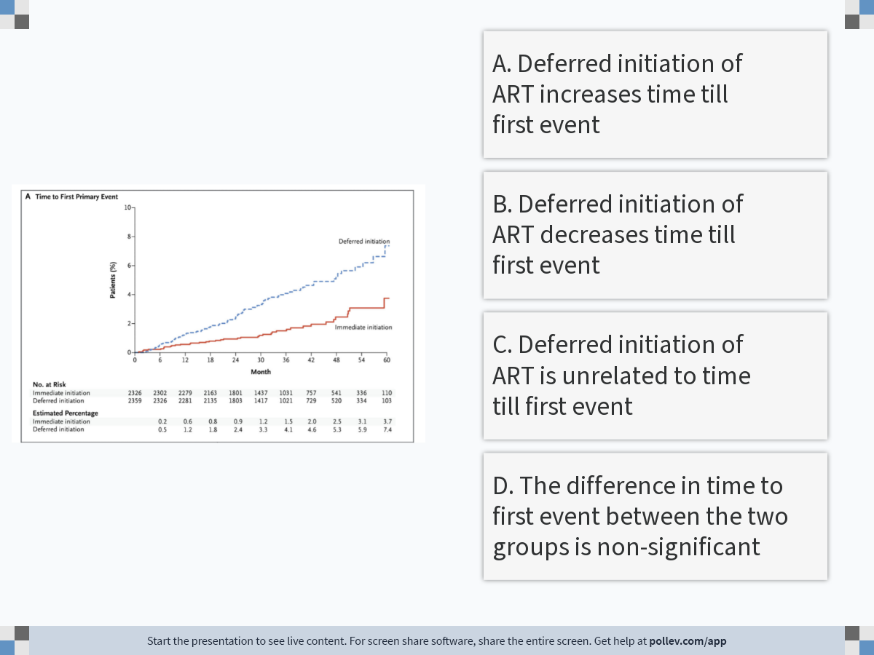
Notes:
Poll Title: Do not modify the notes in this section to avoid tampering with the Poll Everywhere activity. More info at polleverywhere.com/support see picture below https://www.polleverywhere.com/multiple_choice_polls/zamgxKF4HUR2LB9xrvY8p?display_state=instructions&activity_state=opened&state=opened&flow=Engagement&onscreen=persist

Slide 8
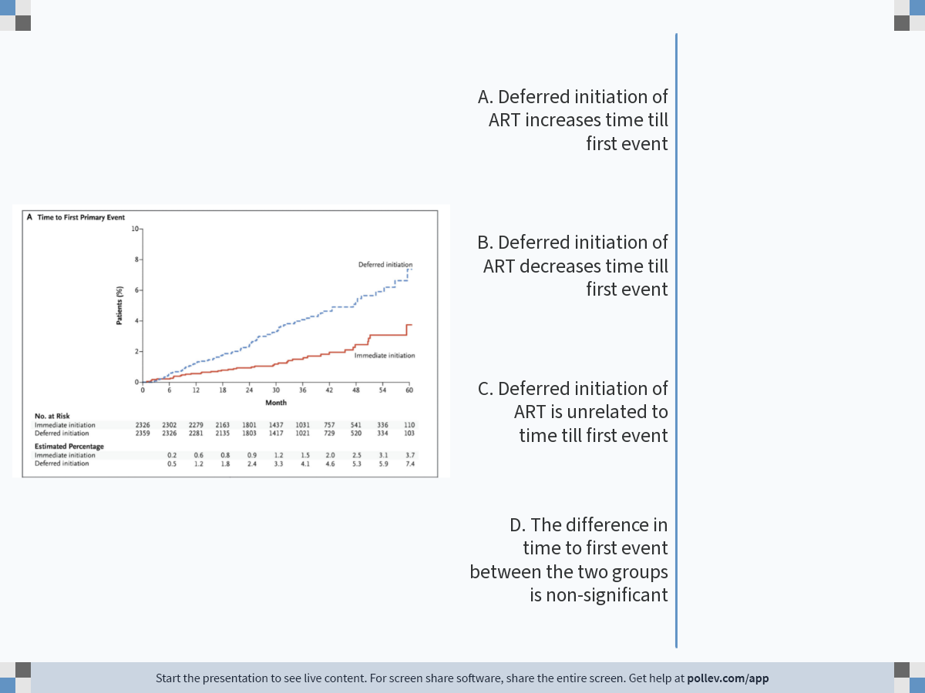
Notes:
Poll Title: Do not modify the notes in this section to avoid tampering with the Poll Everywhere activity. More info at polleverywhere.com/support see picture below https://www.polleverywhere.com/multiple_choice_polls/zamgxKF4HUR2LB9xrvY8p?display_state=chart&activity_state=opened&state=opened&flow=Engagement&onscreen=persist

Slide 9
Notes:
Poll Title: Do not modify the notes in this section to avoid tampering with the Poll Everywhere activity. More info at polleverywhere.com/support see picture below https://www.polleverywhere.com/multiple_choice_polls/zamgxKF4HUR2LB9xrvY8p?display_state=chart&activity_state=closed&state=closed&flow=Engagement&onscreen=persist

Slide 10
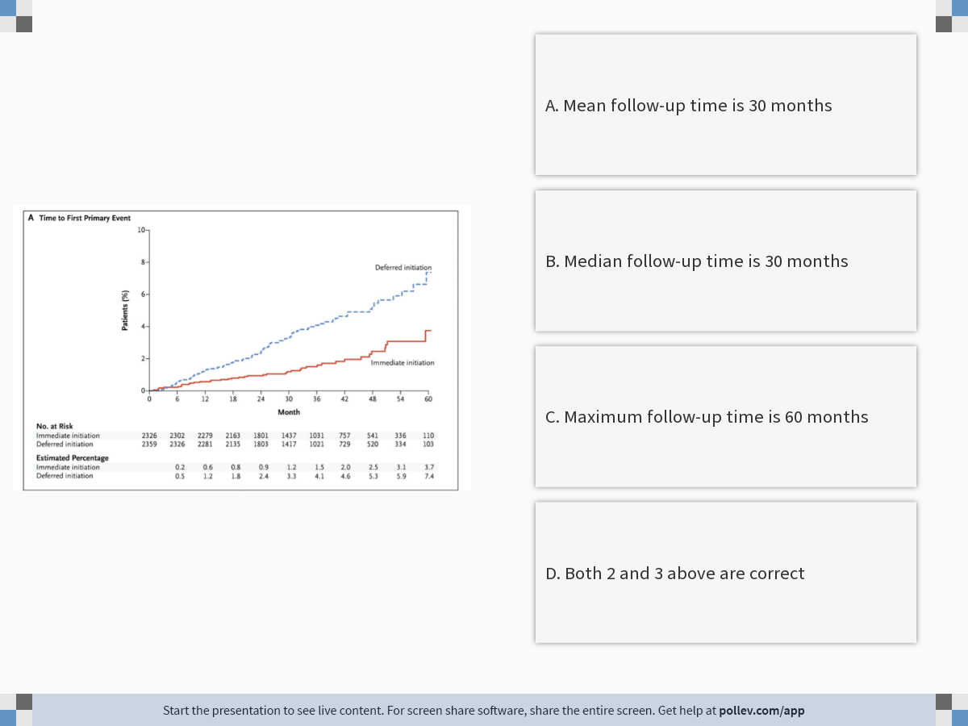
Notes:
Poll Title: Do not modify the notes in this section to avoid tampering with the Poll Everywhere activity. More info at polleverywhere.com/support Question 3 https://www.polleverywhere.com/multiple_choice_polls/Xa5PHkorKFsv1Y58hh1iK?display_state=instructions&activity_state=opened&state=opened&flow=Engagement&onscreen=persist

Slide 11
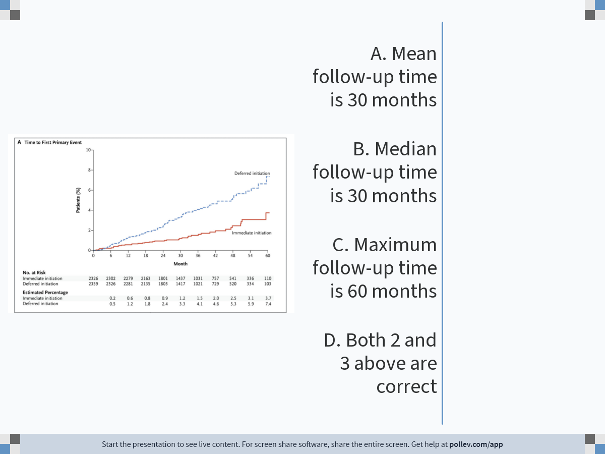
Notes:
Poll Title: Do not modify the notes in this section to avoid tampering with the Poll Everywhere activity. More info at polleverywhere.com/support Question 3 https://www.polleverywhere.com/multiple_choice_polls/Xa5PHkorKFsv1Y58hh1iK?display_state=chart&activity_state=opened&state=opened&flow=Engagement&onscreen=persist

Slide 12
Notes:
Poll Title: Do not modify the notes in this section to avoid tampering with the Poll Everywhere activity. More info at polleverywhere.com/support Question 3 https://www.polleverywhere.com/multiple_choice_polls/Xa5PHkorKFsv1Y58hh1iK?display_state=chart&activity_state=closed&state=closed&flow=Engagement&onscreen=persist

Slide 13
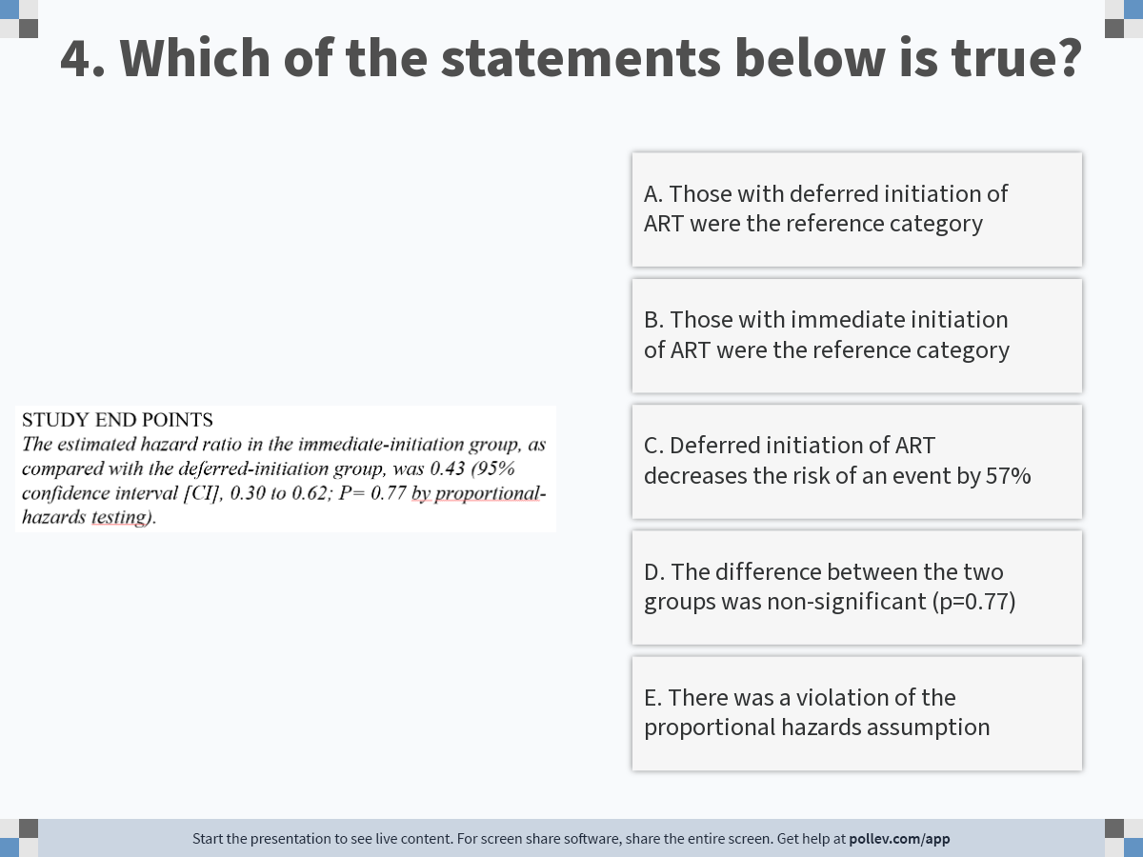
Notes:
Poll Title: Do not modify the notes in this section to avoid tampering with the Poll Everywhere activity. More info at polleverywhere.com/support 4. Which of the statements below is true? https://www.polleverywhere.com/multiple_choice_polls/WNU1TT8RaF2ii2ZraZys9?display_state=instructions&activity_state=opened&state=opened&flow=Engagement&onscreen=persist

Slide 14
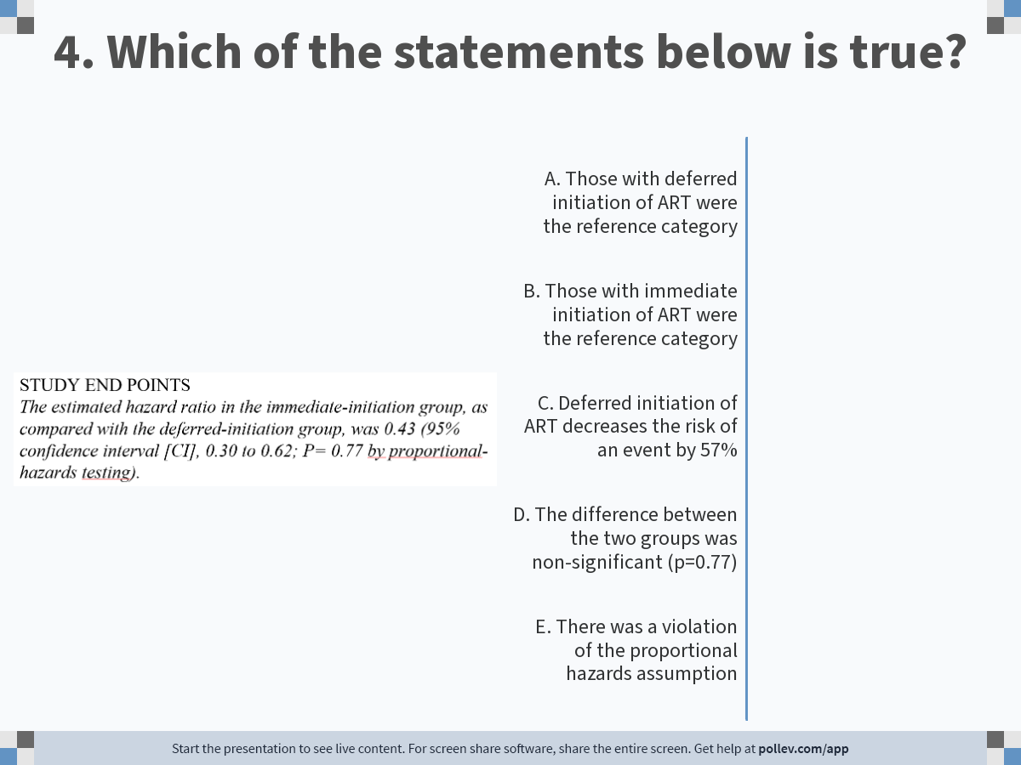
Notes:
Poll Title: Do not modify the notes in this section to avoid tampering with the Poll Everywhere activity. More info at polleverywhere.com/support 4. Which of the statements below is true? https://www.polleverywhere.com/multiple_choice_polls/WNU1TT8RaF2ii2ZraZys9?display_state=chart&activity_state=opened&state=opened&flow=Engagement&onscreen=persist

Slide 15
Notes:
Poll Title: Do not modify the notes in this section to avoid tampering with the Poll Everywhere activity. More info at polleverywhere.com/support 4. Which of the statements below is true? https://www.polleverywhere.com/multiple_choice_polls/WNU1TT8RaF2ii2ZraZys9?display_state=chart&activity_state=closed&state=closed&flow=Engagement&onscreen=persist

Slide 16
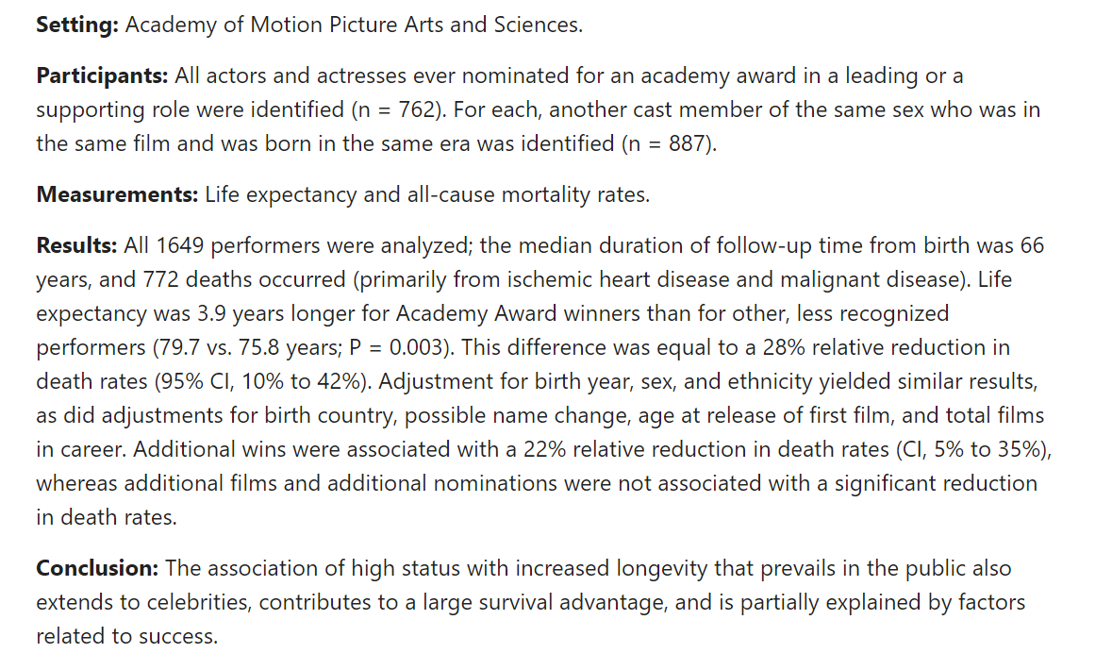
Survival in Academy Award-winning actors and actresses
Redelmeier and Singh, Ann Intern Med 2001 May 15;134(10):955-62

Slide 17
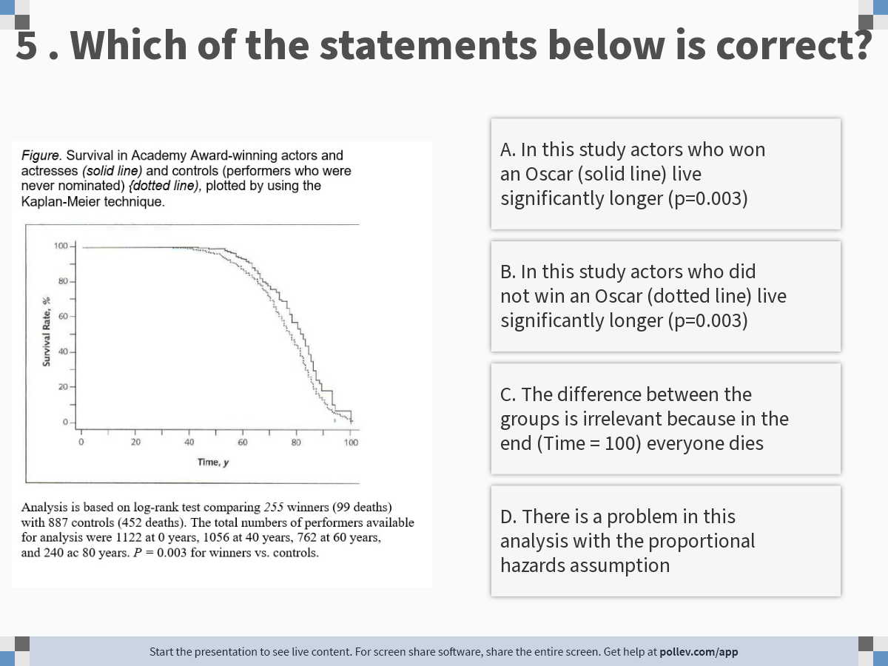
Notes:
Poll Title: Do not modify the notes in this section to avoid tampering with the Poll Everywhere activity. More info at polleverywhere.com/support 5 . Which of the statements below is correct? https://www.polleverywhere.com/multiple_choice_polls/pKy5JcFDDqj7aqgiEUp5N?display_state=instructions&activity_state=opened&state=opened&flow=Engagement&onscreen=persist

Slide 18
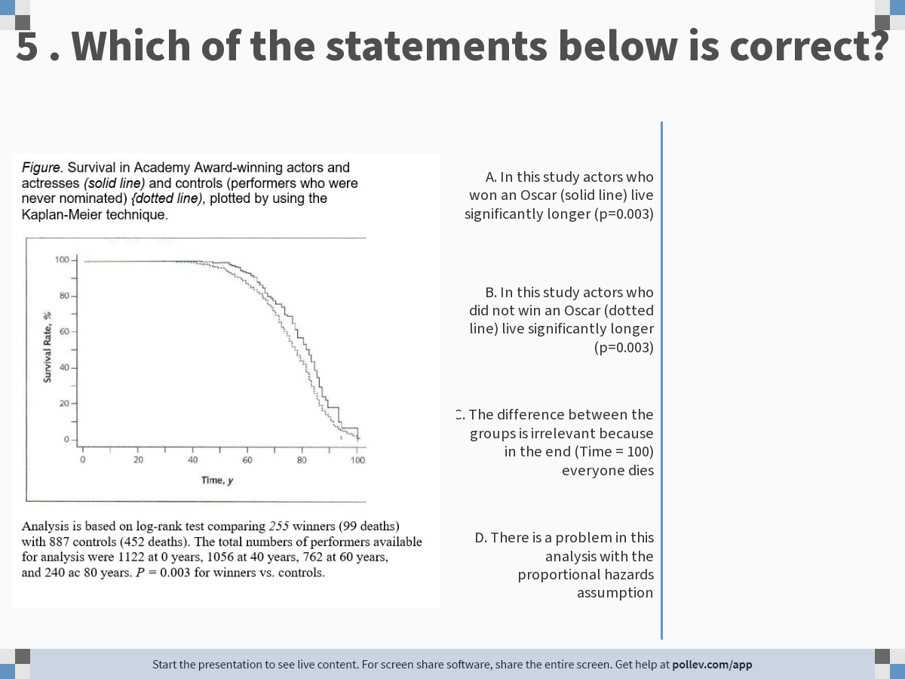
Notes:
Poll Title: Do not modify the notes in this section to avoid tampering with the Poll Everywhere activity. More info at polleverywhere.com/support 5 . Which of the statements below is correct? https://www.polleverywhere.com/multiple_choice_polls/pKy5JcFDDqj7aqgiEUp5N?display_state=chart&activity_state=opened&state=opened&flow=Engagement&onscreen=persist

Slide 19
Notes:
Poll Title: Do not modify the notes in this section to avoid tampering with the Poll Everywhere activity. More info at polleverywhere.com/support 5 . Which of the statements below is correct? https://www.polleverywhere.com/multiple_choice_polls/pKy5JcFDDqj7aqgiEUp5N?display_state=chart&activity_state=closed&state=closed&flow=Engagement&onscreen=persist

Slide 20
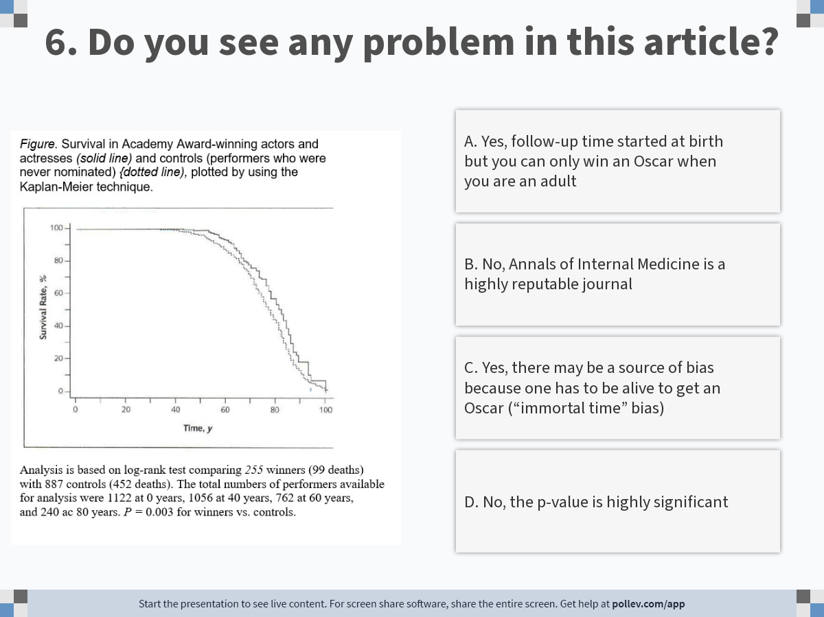
Notes:
Poll Title: Do not modify the notes in this section to avoid tampering with the Poll Everywhere activity. More info at polleverywhere.com/support 6. Do you see any problem in this article? https://www.polleverywhere.com/multiple_choice_polls/KbxByP0RLn2M63CY5jWYt?display_state=instructions&activity_state=opened&state=opened&flow=Engagement&onscreen=persist

Slide 21
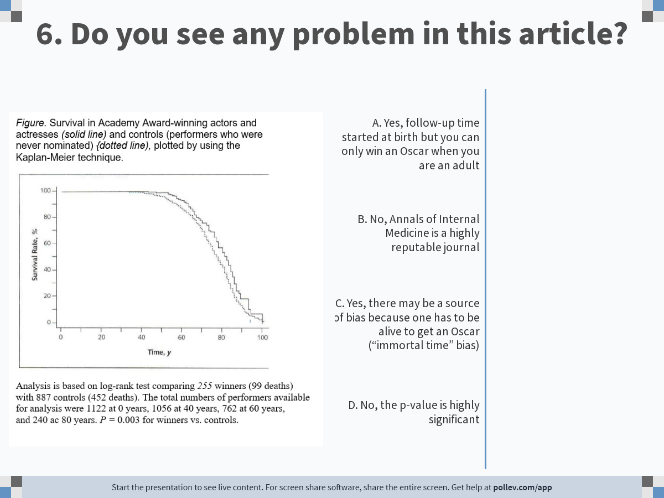
Notes:
Poll Title: Do not modify the notes in this section to avoid tampering with the Poll Everywhere activity. More info at polleverywhere.com/support 6. Do you see any problem in this article? https://www.polleverywhere.com/multiple_choice_polls/KbxByP0RLn2M63CY5jWYt?display_state=chart&activity_state=opened&state=opened&flow=Engagement&onscreen=persist

Slide 22
Notes:
Poll Title: Do not modify the notes in this section to avoid tampering with the Poll Everywhere activity. More info at polleverywhere.com/support 6. Do you see any problem in this article? https://www.polleverywhere.com/multiple_choice_polls/KbxByP0RLn2M63CY5jWYt?display_state=chart&activity_state=closed&state=closed&flow=Engagement&onscreen=persist

Slide 23
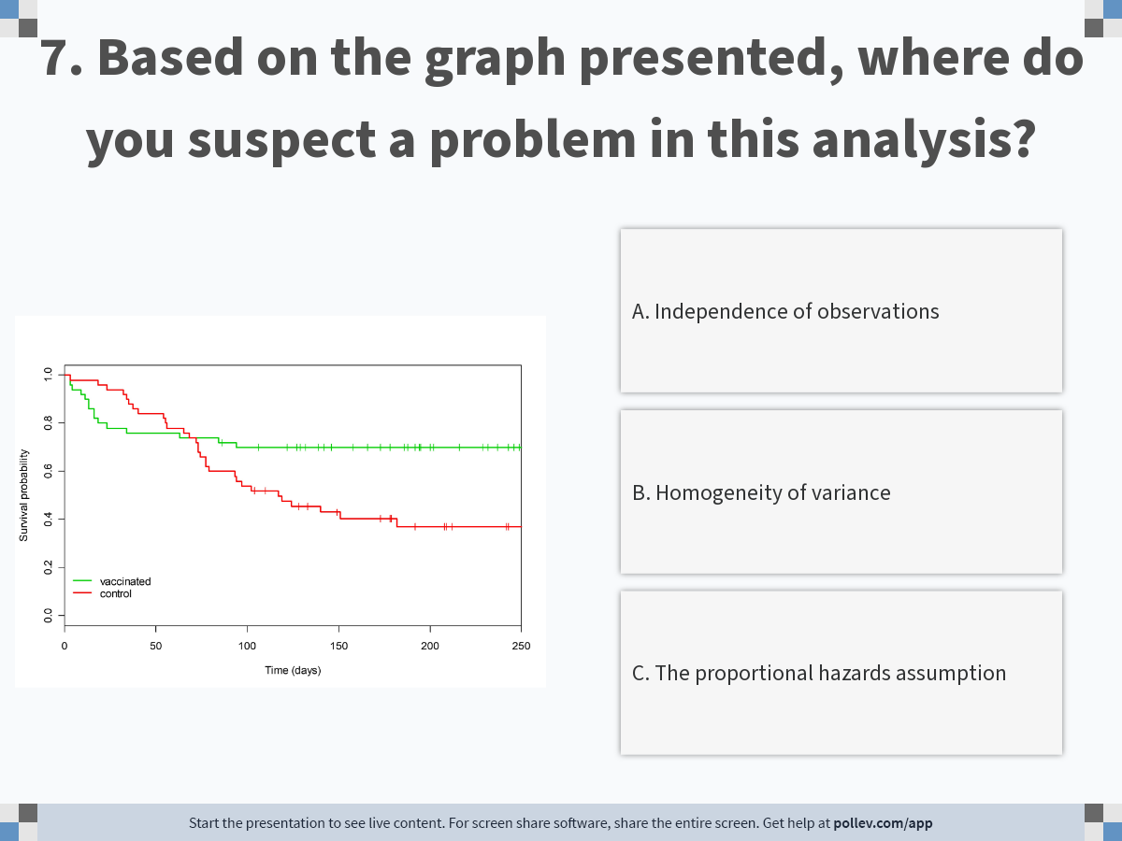
Notes:
Poll Title: Do not modify the notes in this section to avoid tampering with the Poll Everywhere activity. More info at polleverywhere.com/support 7. Based on the graph presented, where do you suspect a problem in this analysis? https://www.polleverywhere.com/multiple_choice_polls/42uUubYK2CYJ1dsMlogLQ?display_state=instructions&activity_state=opened&state=opened&flow=Engagement&onscreen=persist

Slide 24
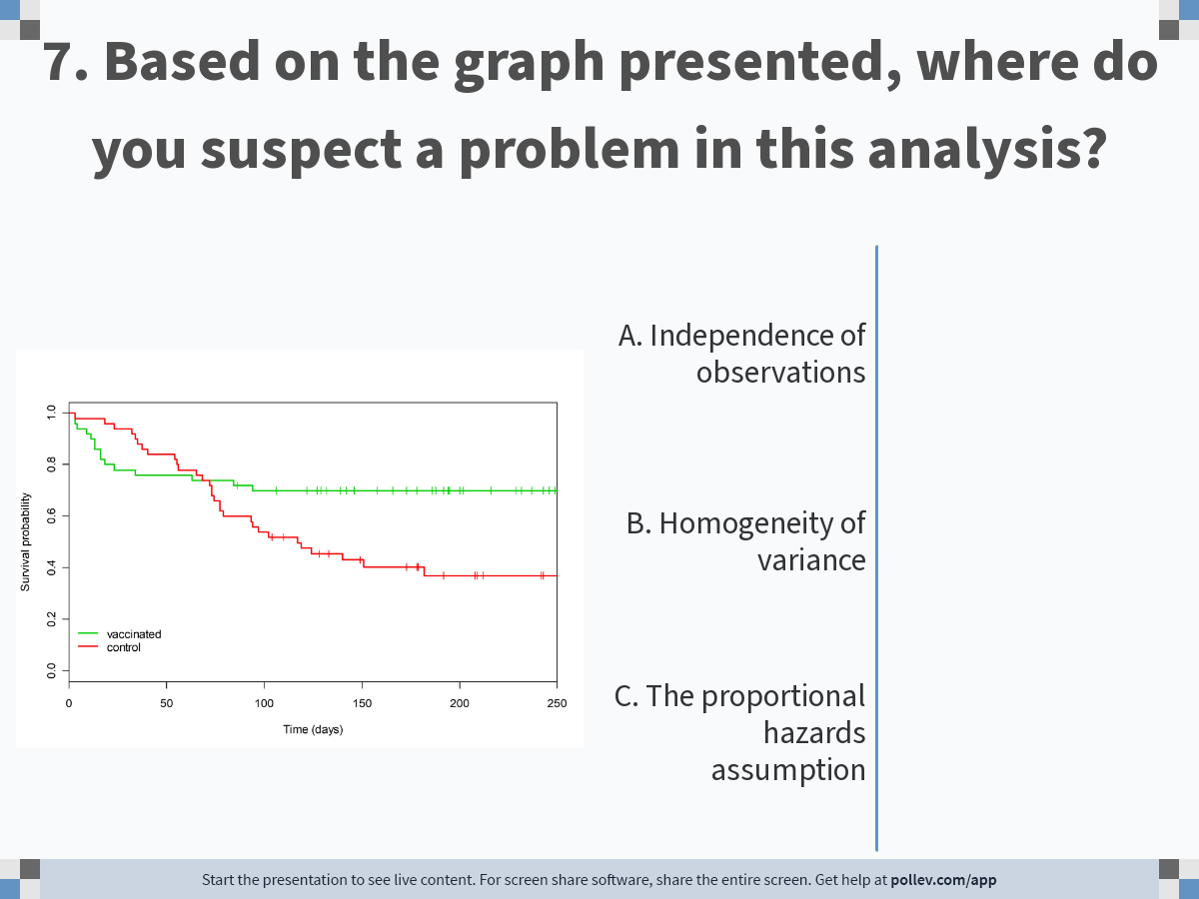
Notes:
Poll Title: Do not modify the notes in this section to avoid tampering with the Poll Everywhere activity. More info at polleverywhere.com/support 7. Based on the graph presented, where do you suspect a problem in this analysis? https://www.polleverywhere.com/multiple_choice_polls/42uUubYK2CYJ1dsMlogLQ?display_state=chart&activity_state=opened&state=opened&flow=Engagement&onscreen=persist

Slide 25
Notes:
Poll Title: Do not modify the notes in this section to avoid tampering with the Poll Everywhere activity. More info at polleverywhere.com/support 7. Based on the graph presented, where do you suspect a problem in this analysis? https://www.polleverywhere.com/multiple_choice_polls/42uUubYK2CYJ1dsMlogLQ?display_state=chart&activity_state=closed&state=closed&flow=Engagement&onscreen=persist

Slide 26
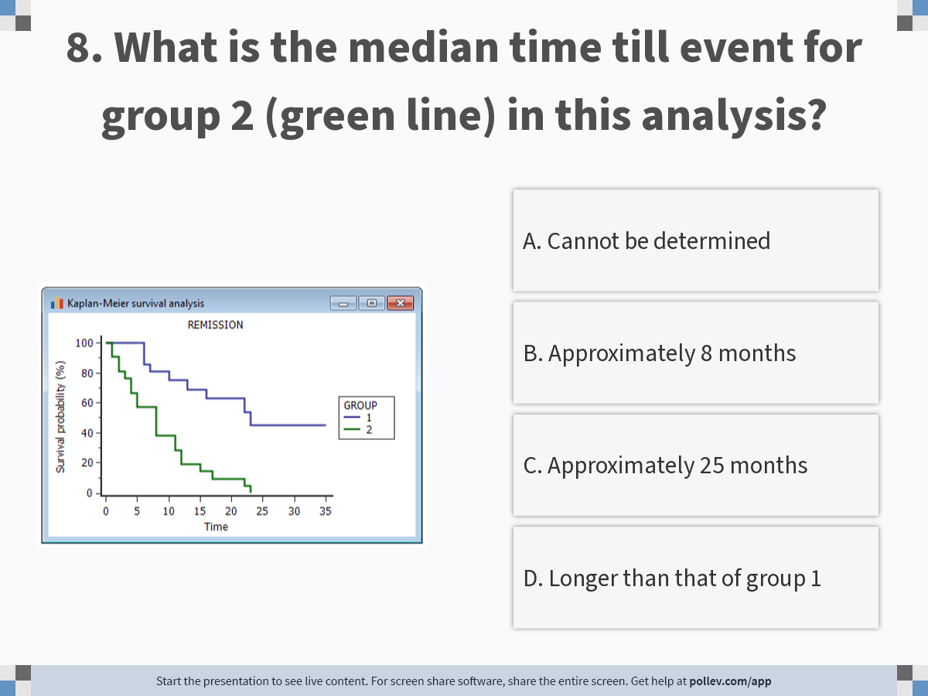
Notes:
Poll Title: Do not modify the notes in this section to avoid tampering with the Poll Everywhere activity. More info at polleverywhere.com/support 8. What is the median time till event for group 2 (green line) in this analysis? https://www.polleverywhere.com/multiple_choice_polls/UkWNp6Uj0gns9l54gxWeV?display_state=instructions&activity_state=opened&state=opened&flow=Engagement&onscreen=persist

Slide 27
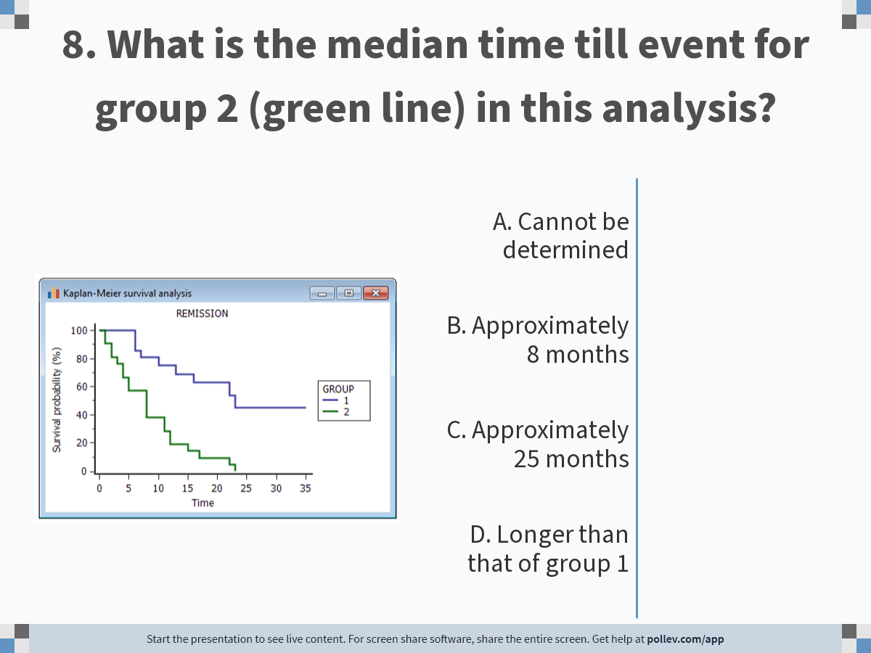
Notes:
Poll Title: Do not modify the notes in this section to avoid tampering with the Poll Everywhere activity. More info at polleverywhere.com/support 8. What is the median time till event for group 2 (green line) in this analysis? https://www.polleverywhere.com/multiple_choice_polls/UkWNp6Uj0gns9l54gxWeV?display_state=chart&activity_state=opened&state=opened&flow=Engagement&onscreen=persist

Slide 28
Notes:
Poll Title: Do not modify the notes in this section to avoid tampering with the Poll Everywhere activity. More info at polleverywhere.com/support 8. What is the median time till event for group 2 (green line) in this analysis? https://www.polleverywhere.com/multiple_choice_polls/UkWNp6Uj0gns9l54gxWeV?display_state=chart&activity_state=closed&state=closed&flow=Engagement&onscreen=persist

Slide 29
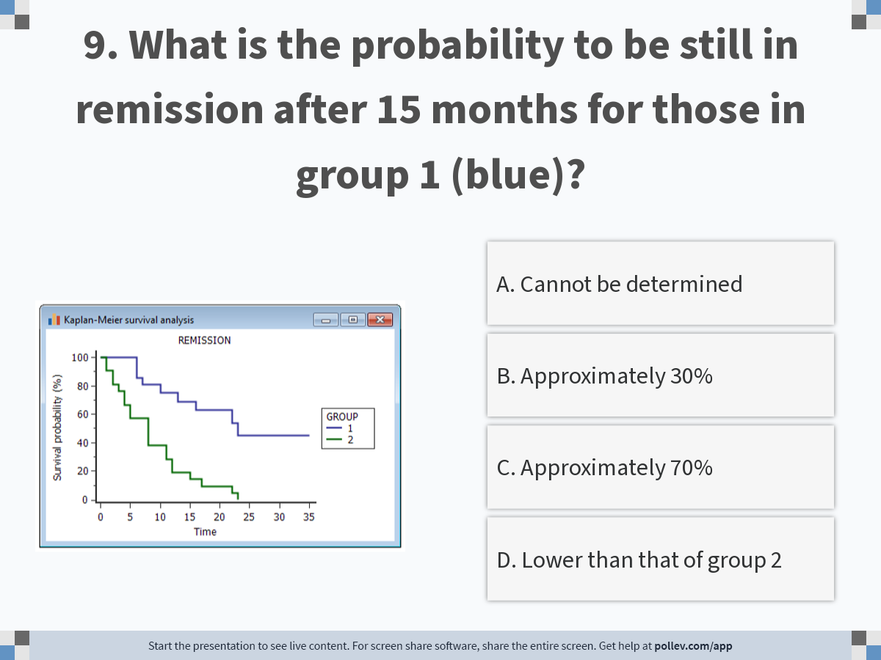
Notes:
Poll Title: Do not modify the notes in this section to avoid tampering with the Poll Everywhere activity. More info at polleverywhere.com/support 9. What is the probability to be still in remission after 15 months for those in group 1 (blue)? https://www.polleverywhere.com/multiple_choice_polls/JA44At5hrIoYTrvhsVXxa?display_state=instructions&activity_state=opened&state=opened&flow=Engagement&onscreen=persist

Slide 30
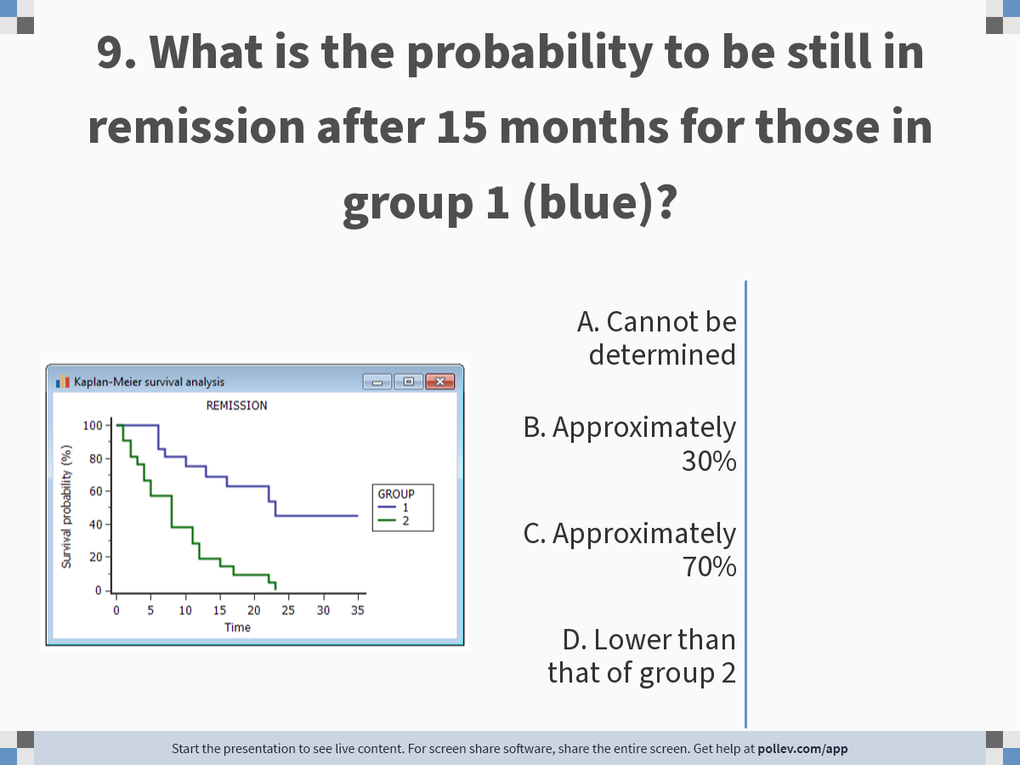
Notes:
Poll Title: Do not modify the notes in this section to avoid tampering with the Poll Everywhere activity. More info at polleverywhere.com/support 9. What is the probability to be still in remission after 15 months for those in group 1 (blue)? https://www.polleverywhere.com/multiple_choice_polls/JA44At5hrIoYTrvhsVXxa?display_state=chart&activity_state=opened&state=opened&flow=Engagement&onscreen=persist

Slide 31
Notes:
Poll Title: Do not modify the notes in this section to avoid tampering with the Poll Everywhere activity. More info at polleverywhere.com/support 9. What is the probability to be still in remission after 15 months for those in group 1 (blue)? https://www.polleverywhere.com/multiple_choice_polls/JA44At5hrIoYTrvhsVXxa?display_state=chart&activity_state=closed&state=closed&flow=Engagement&onscreen=persist

Slide 32
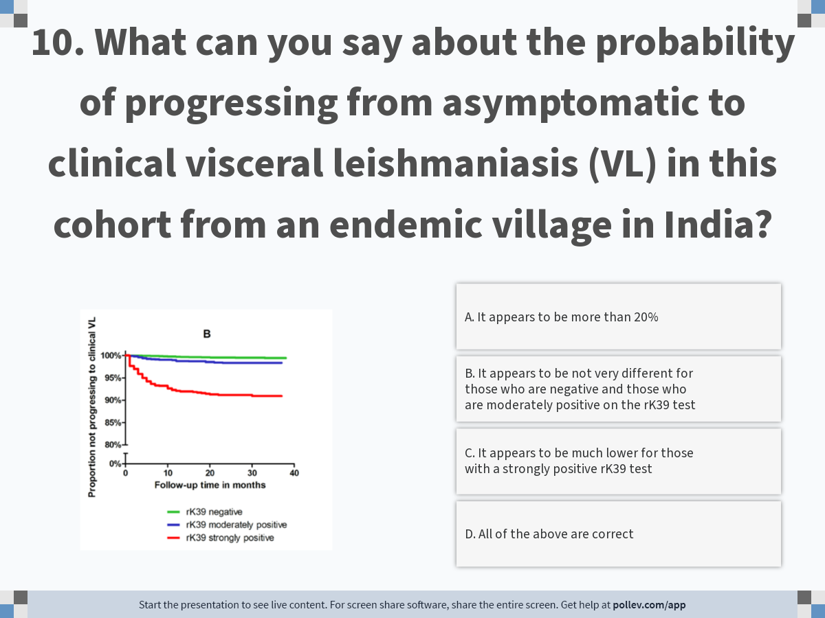
Notes:
Poll Title: Do not modify the notes in this section to avoid tampering with the Poll Everywhere activity. More info at polleverywhere.com/support 10. What can you say about the probability of progressing from asymptomatic to clinical visceral leishmaniasis (VL) in this cohort from an endemic village in India? https://www.polleverywhere.com/multiple_choice_polls/Dnh4SildtboF9OQOwtyiv?display_state=instructions&activity_state=opened&state=opened&flow=Engagement&onscreen=persist

Slide 33
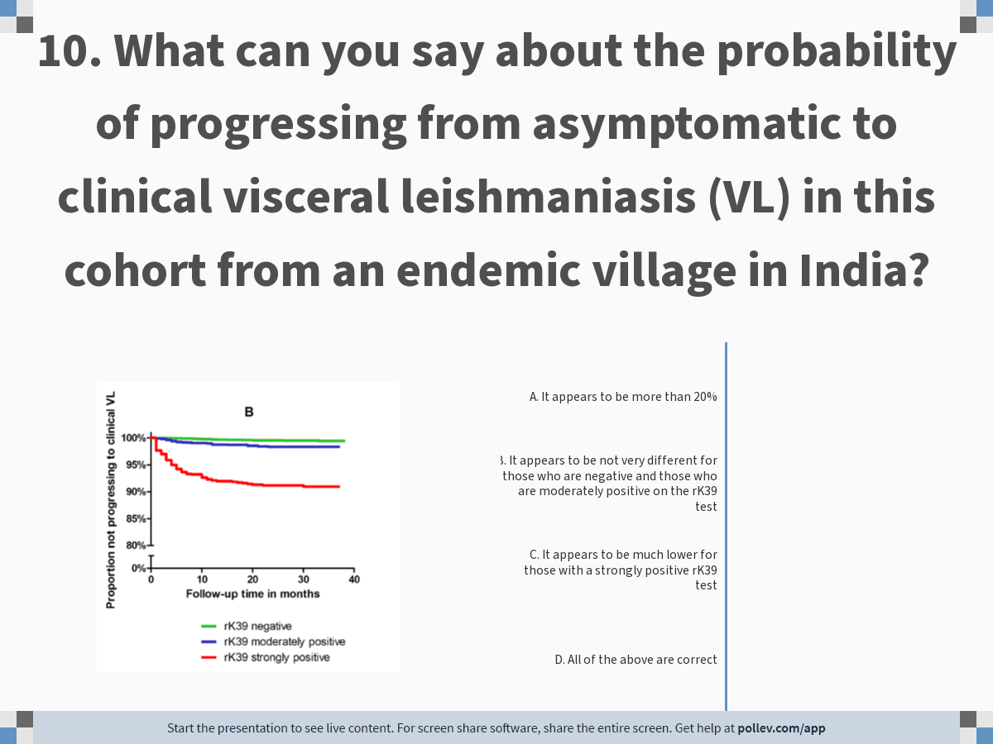
Notes:
Poll Title: Do not modify the notes in this section to avoid tampering with the Poll Everywhere activity. More info at polleverywhere.com/support 10. What can you say about the probability of progressing from asymptomatic to clinical visceral leishmaniasis (VL) in this cohort from an endemic village in India? https://www.polleverywhere.com/multiple_choice_polls/Dnh4SildtboF9OQOwtyiv?display_state=chart&activity_state=opened&state=opened&flow=Engagement&onscreen=persist

Slide 34
Notes:
Poll Title: Do not modify the notes in this section to avoid tampering with the Poll Everywhere activity. More info at polleverywhere.com/support 10. What can you say about the probability of progressing from asymptomatic to clinical visceral leishmaniasis (VL) in this cohort from an endemic village in India? https://www.polleverywhere.com/multiple_choice_polls/Dnh4SildtboF9OQOwtyiv?display_state=chart&activity_state=closed&state=closed&flow=Engagement&onscreen=persist

Slide 35
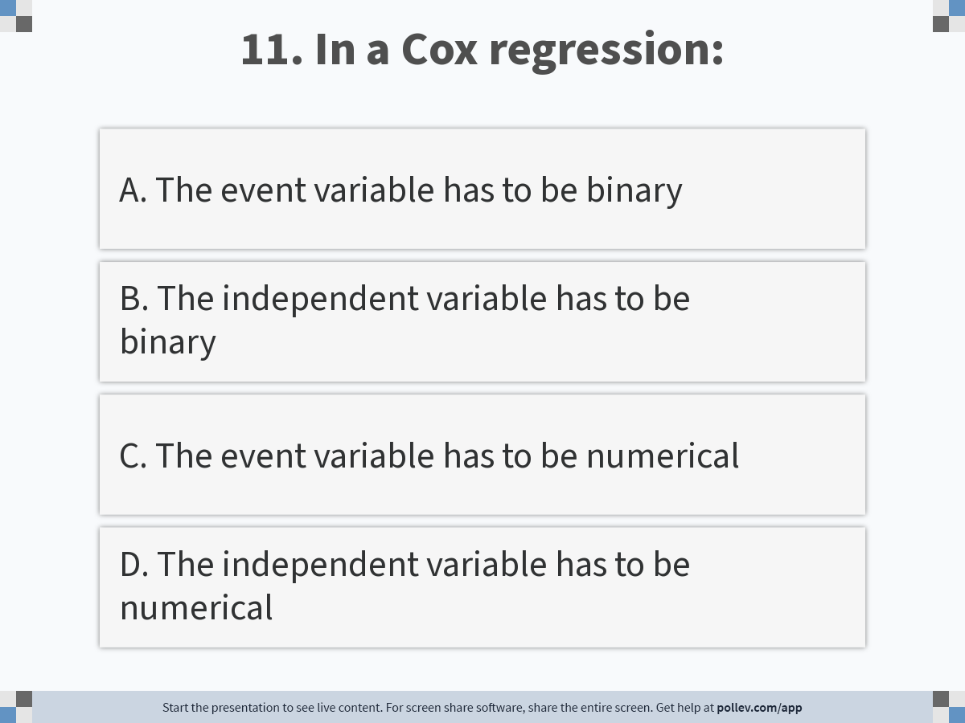
Notes:
Poll Title: Do not modify the notes in this section to avoid tampering with the Poll Everywhere activity. More info at polleverywhere.com/support 11. In a Cox regression: https://www.polleverywhere.com/multiple_choice_polls/eKmcWtSeYKFUjZroDm6fe?display_state=instructions&activity_state=opened&state=opened&flow=Engagement&onscreen=persist

Slide 36
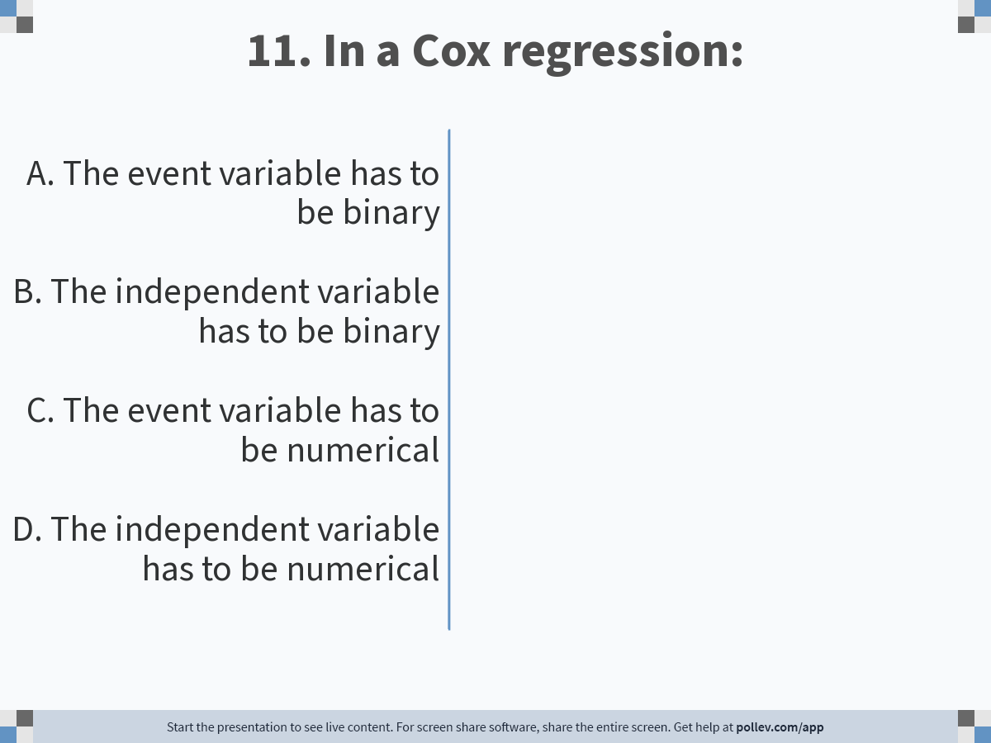
Notes:
Poll Title: Do not modify the notes in this section to avoid tampering with the Poll Everywhere activity. More info at polleverywhere.com/support 11. In a Cox regression: https://www.polleverywhere.com/multiple_choice_polls/eKmcWtSeYKFUjZroDm6fe?display_state=chart&activity_state=opened&state=opened&flow=Engagement&onscreen=persist

Slide 37
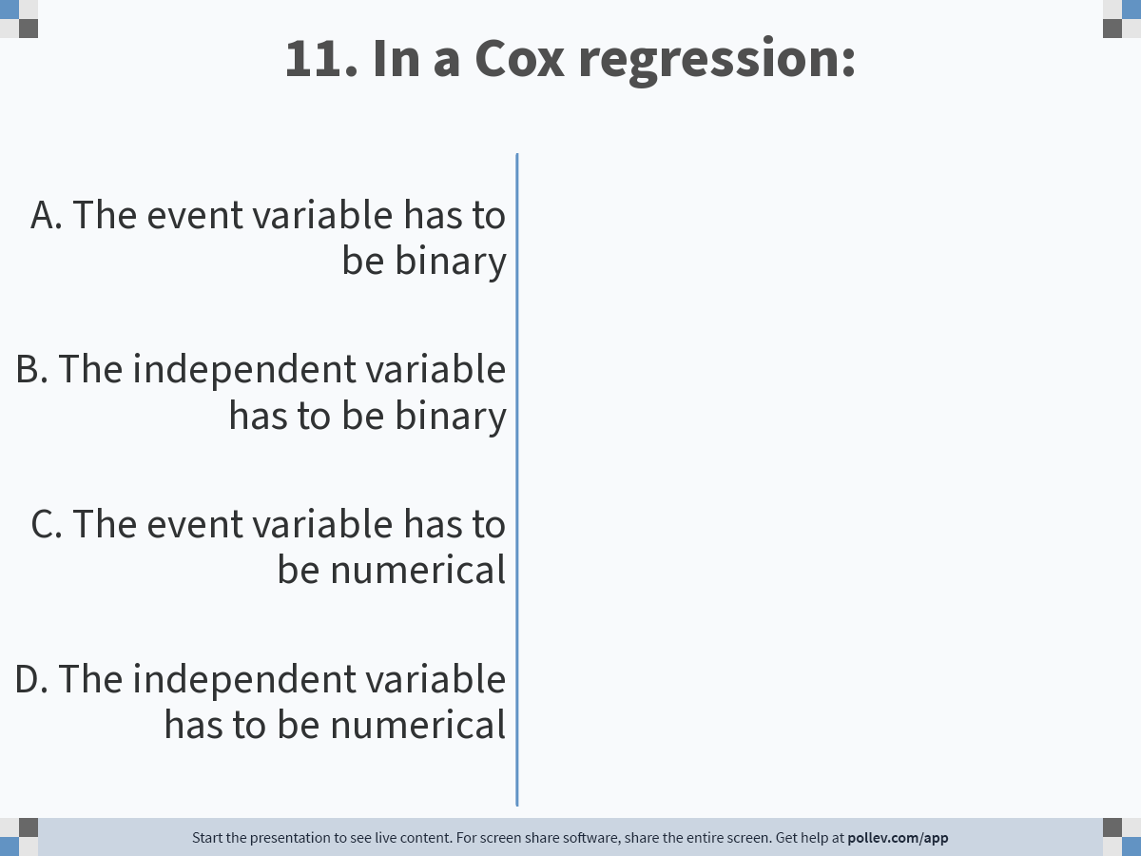
Notes:
Poll Title: Do not modify the notes in this section to avoid tampering with the Poll Everywhere activity. More info at polleverywhere.com/support 11. In a Cox regression: https://www.polleverywhere.com/multiple_choice_polls/eKmcWtSeYKFUjZroDm6fe?display_state=chart&activity_state=closed&state=closed&flow=Engagement&onscreen=persist

Slide 38
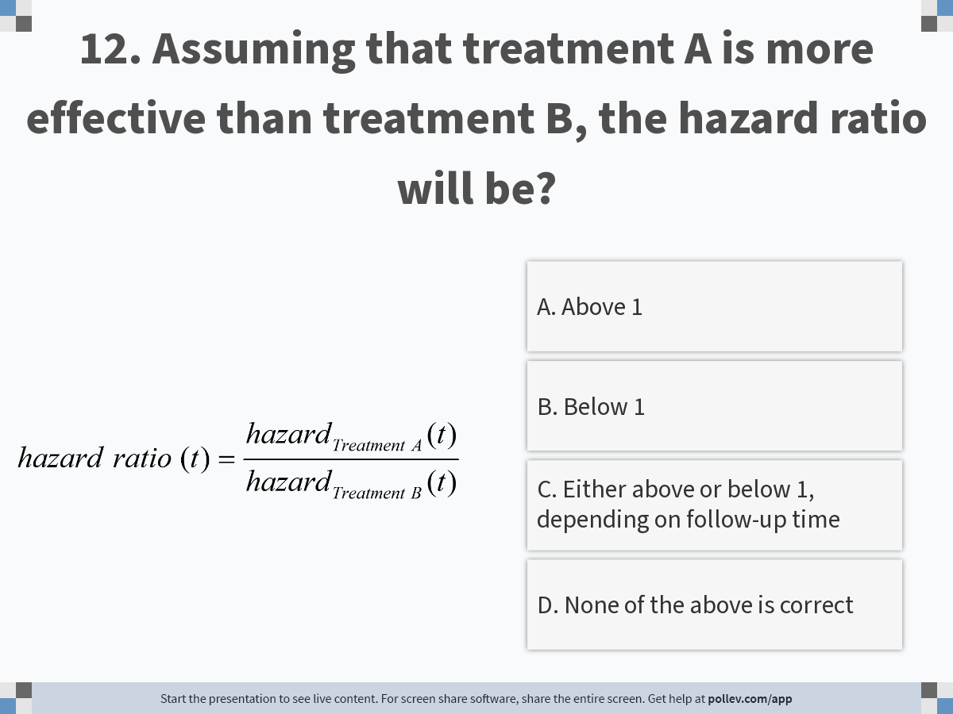
Notes:
Poll Title: Do not modify the notes in this section to avoid tampering with the Poll Everywhere activity. More info at polleverywhere.com/support 12. Assuming that treatment A is more effective than treatment B, the hazard ratio will be? https://www.polleverywhere.com/multiple_choice_polls/q8ZYP1RVa2MSmAsVc73tL?display_state=instructions&activity_state=opened&state=opened&flow=Engagement&onscreen=persist

Slide 39
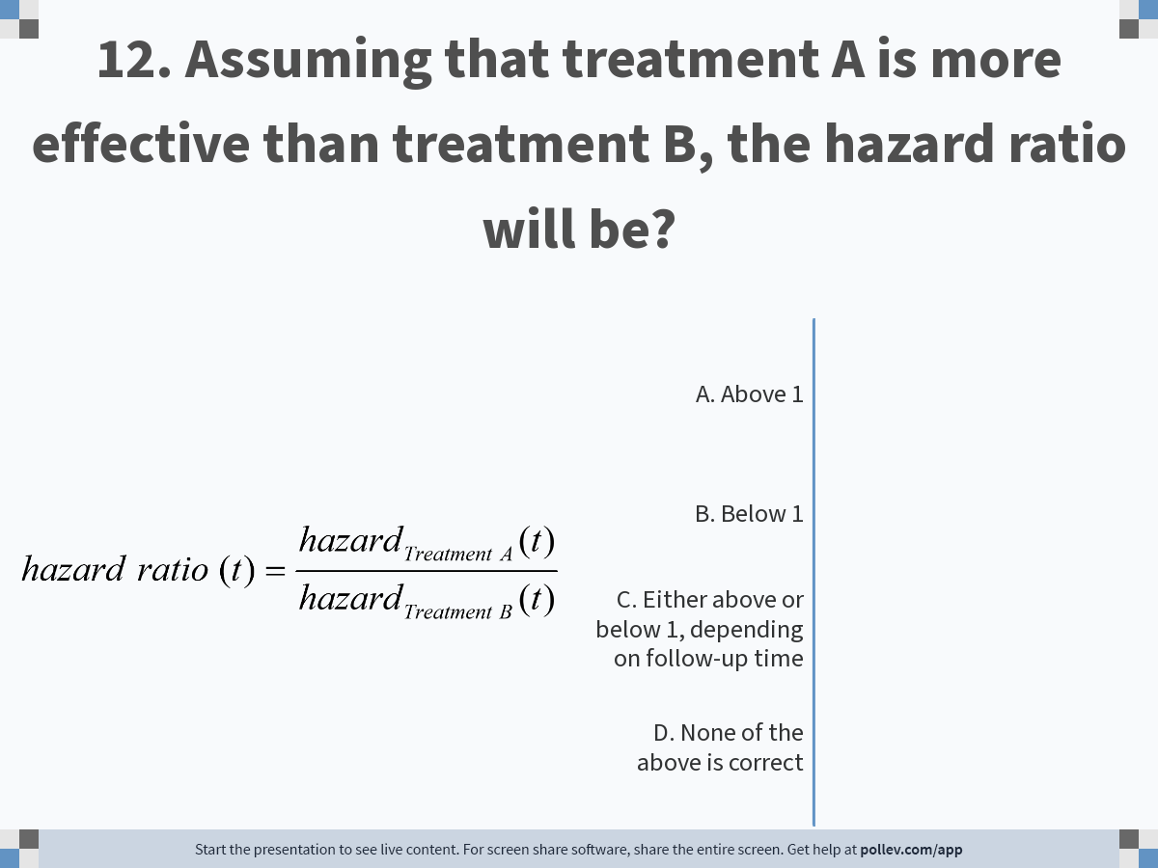
Notes:
Poll Title: Do not modify the notes in this section to avoid tampering with the Poll Everywhere activity. More info at polleverywhere.com/support 12. Assuming that treatment A is more effective than treatment B, the hazard ratio will be? https://www.polleverywhere.com/multiple_choice_polls/q8ZYP1RVa2MSmAsVc73tL?display_state=chart&activity_state=opened&state=opened&flow=Engagement&onscreen=persist

Slide 40
Notes:
Poll Title: Do not modify the notes in this section to avoid tampering with the Poll Everywhere activity. More info at polleverywhere.com/support 12. Assuming that treatment A is more effective than treatment B, the hazard ratio will be? https://www.polleverywhere.com/multiple_choice_polls/q8ZYP1RVa2MSmAsVc73tL?display_state=chart&activity_state=closed&state=closed&flow=Engagement&onscreen=persist

Slide 41
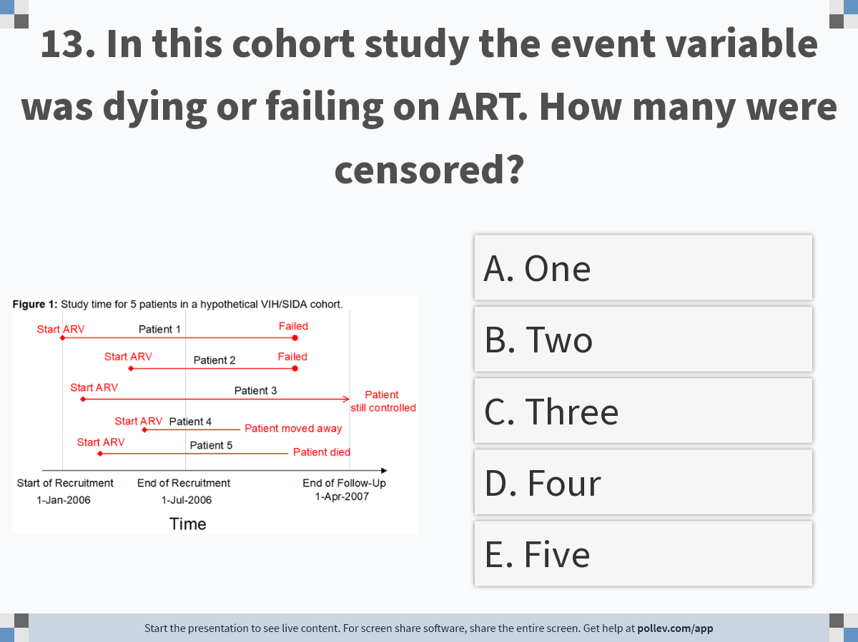
Notes:
Poll Title: Do not modify the notes in this section to avoid tampering with the Poll Everywhere activity. More info at polleverywhere.com/support 13. In this cohort study the event variable was dying or failing on ART. How many were censored? https://www.polleverywhere.com/multiple_choice_polls/rgTb149EZHlG3alzBwjBi?display_state=instructions&activity_state=opened&state=opened&flow=Engagement&onscreen=persist

Slide 42
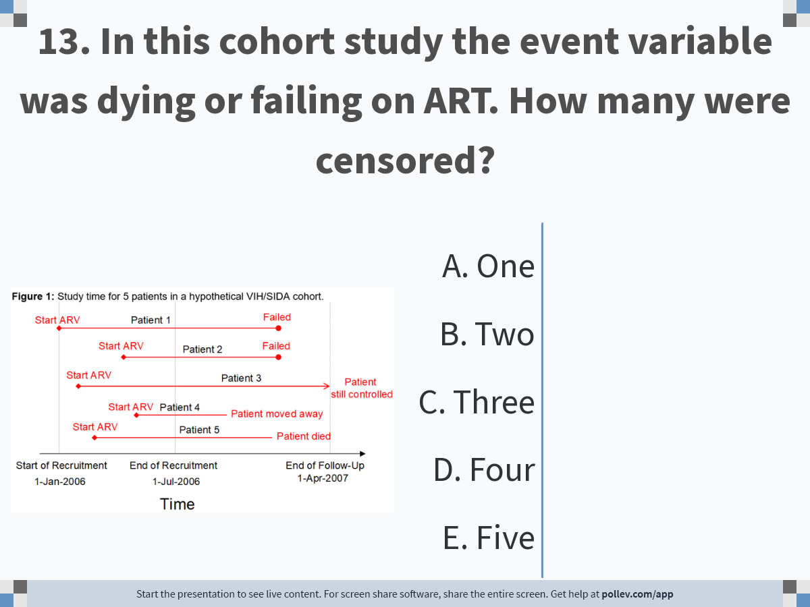
Notes:
Poll Title: Do not modify the notes in this section to avoid tampering with the Poll Everywhere activity. More info at polleverywhere.com/support 13. In this cohort study the event variable was dying or failing on ART. How many were censored? https://www.polleverywhere.com/multiple_choice_polls/rgTb149EZHlG3alzBwjBi?display_state=chart&activity_state=opened&state=opened&flow=Engagement&onscreen=persist

Slide 43
Notes:
Poll Title: Do not modify the notes in this section to avoid tampering with the Poll Everywhere activity. More info at polleverywhere.com/support 13. In this cohort study the event variable was dying or failing on ART. How many were censored? https://www.polleverywhere.com/multiple_choice_polls/rgTb149EZHlG3alzBwjBi?display_state=chart&activity_state=closed&state=closed&flow=Engagement&onscreen=persist

Slide 44
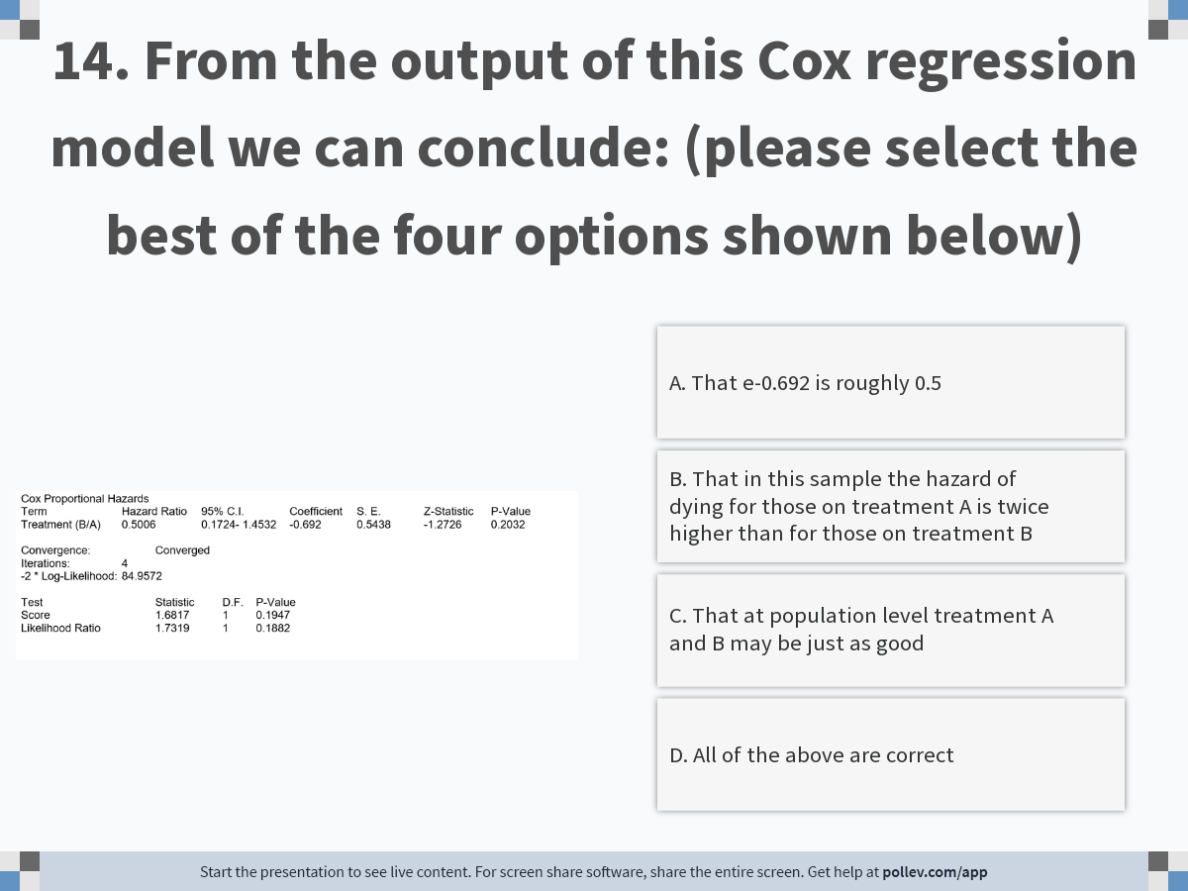
Notes:
Poll Title: Do not modify the notes in this section to avoid tampering with the Poll Everywhere activity. More info at polleverywhere.com/support 14. From the output of this Cox regression model we can conclude: https://www.polleverywhere.com/multiple_choice_polls/uQiAO0RulaiGyJMBQhiZS?display_state=instructions&activity_state=opened&state=opened&flow=Engagement&onscreen=persist

Slide 45
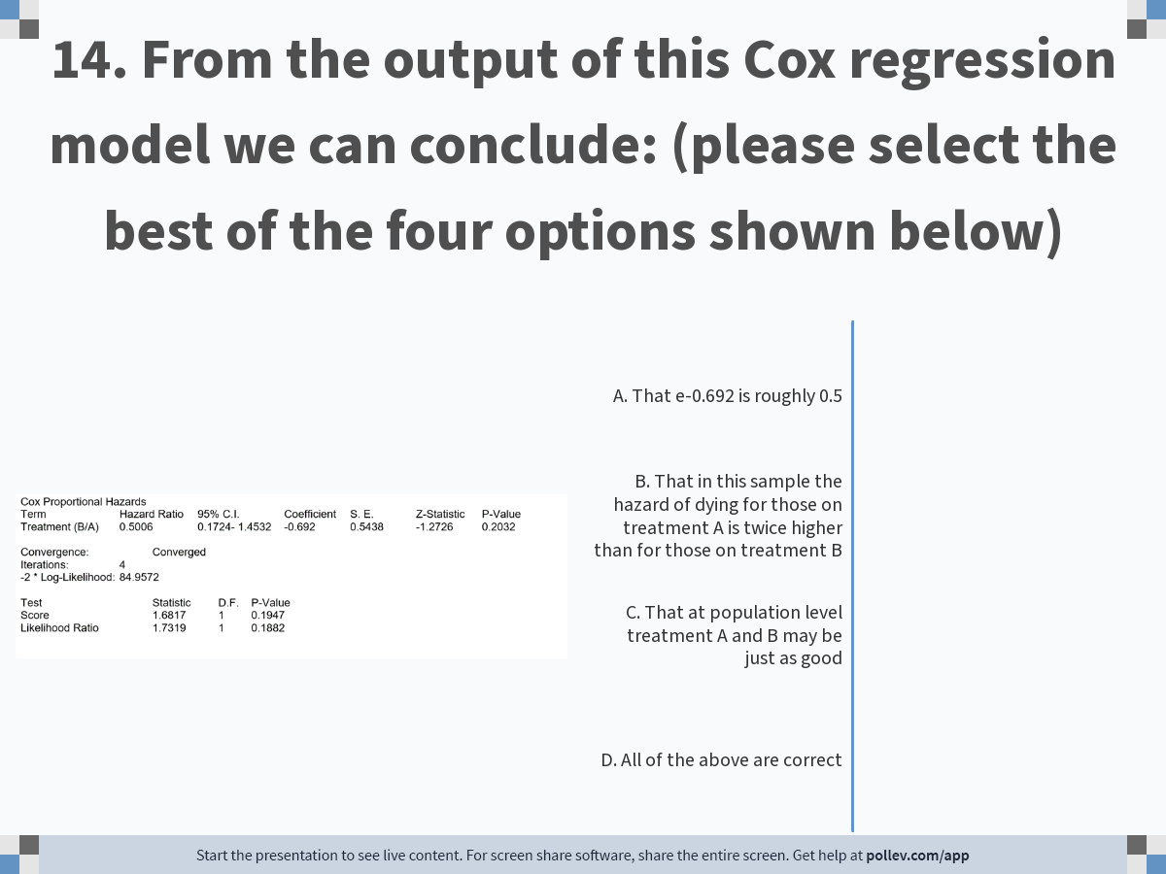
Notes:
Poll Title: Do not modify the notes in this section to avoid tampering with the Poll Everywhere activity. More info at polleverywhere.com/support 14. From the output of this Cox regression model we can conclude: https://www.polleverywhere.com/multiple_choice_polls/uQiAO0RulaiGyJMBQhiZS?display_state=chart&activity_state=opened&state=opened&flow=Engagement&onscreen=persist

Slide 46
Notes:
Poll Title: Do not modify the notes in this section to avoid tampering with the Poll Everywhere activity. More info at polleverywhere.com/support 14. From the output of this Cox regression model we can conclude: https://www.polleverywhere.com/multiple_choice_polls/uQiAO0RulaiGyJMBQhiZS?display_state=chart&activity_state=closed&state=closed&flow=Engagement&onscreen=persist

Slide 47
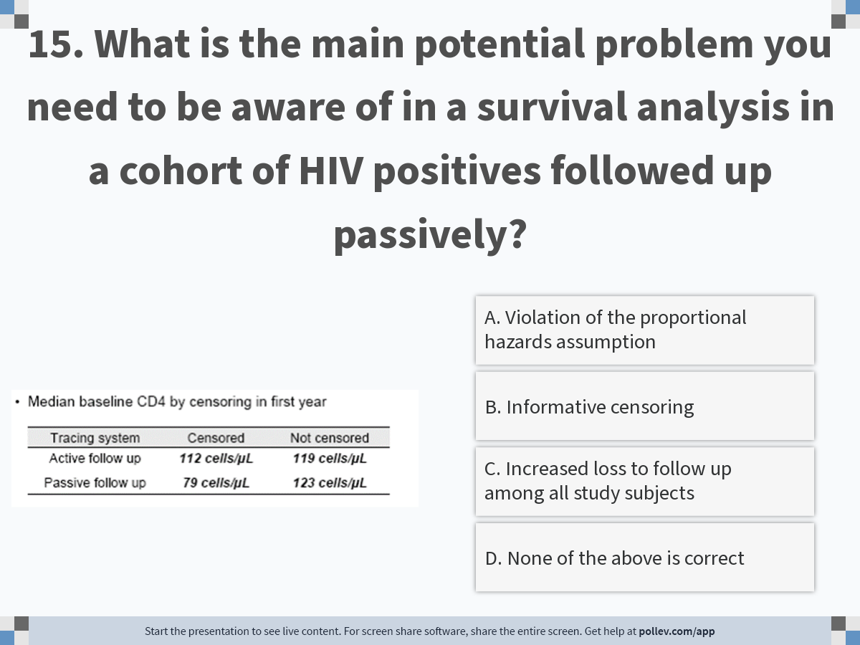
Notes:
Poll Title: Do not modify the notes in this section to avoid tampering with the Poll Everywhere activity. More info at polleverywhere.com/support 15. What is the main potential problem you need to be aware of in a survival analysis in a cohort of HIV positives followed up passively? https://www.polleverywhere.com/multiple_choice_polls/SsIrrZSgmXWopthlXjdQl?display_state=instructions&activity_state=opened&state=opened&flow=Engagement&onscreen=persist

Slide 48
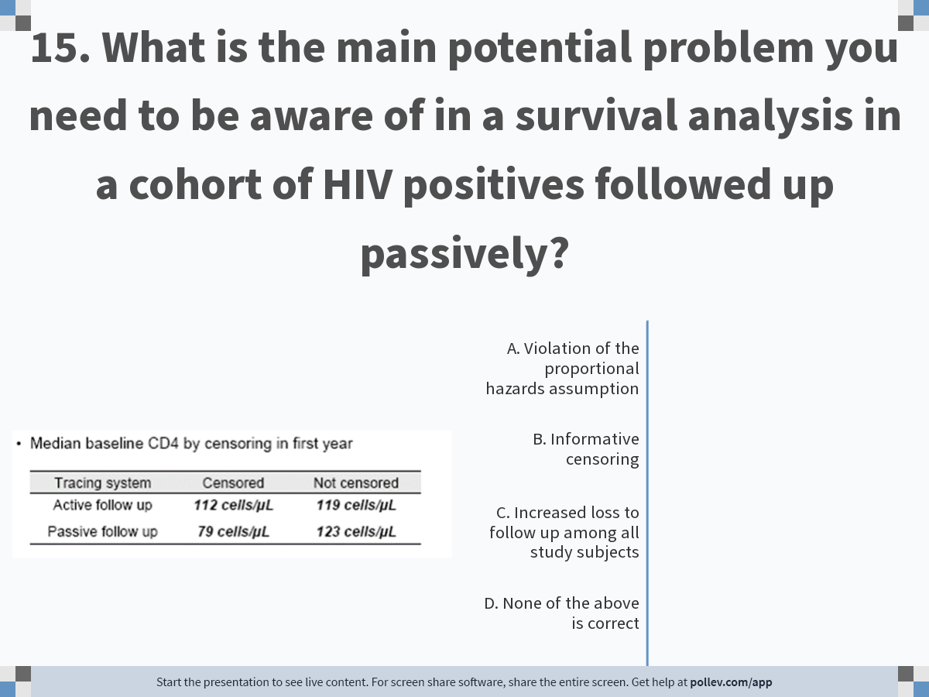
Notes:
Poll Title: Do not modify the notes in this section to avoid tampering with the Poll Everywhere activity. More info at polleverywhere.com/support 15. What is the main potential problem you need to be aware of in a survival analysis in a cohort of HIV positives followed up passively? https://www.polleverywhere.com/multiple_choice_polls/SsIrrZSgmXWopthlXjdQl?display_state=chart&activity_state=opened&state=opened&flow=Engagement&onscreen=persist

Slide 49
Notes:
Poll Title: Do not modify the notes in this section to avoid tampering with the Poll Everywhere activity. More info at polleverywhere.com/support 15. What is the main potential problem you need to be aware of in a survival analysis in a cohort of HIV positives followed up passively? https://www.polleverywhere.com/multiple_choice_polls/SsIrrZSgmXWopthlXjdQl?display_state=chart&activity_state=closed&state=closed&flow=Engagement&onscreen=persist

